Slide 1

Fairness and Complexity Trade-Off
Slides prepared by Makan Arastuie
EECS 6980 - Probabilistic Methods in Data Science Course Project
04/18/2018

Slide 2
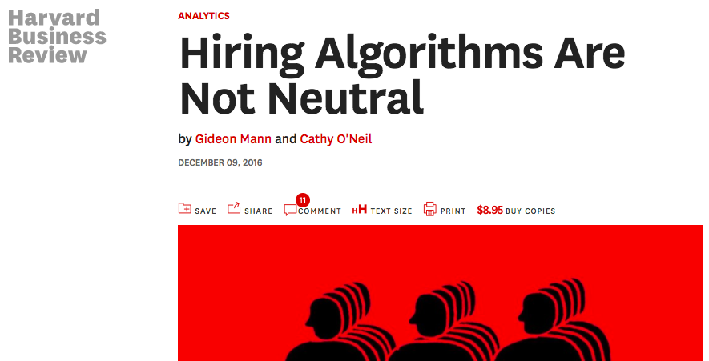
Why Fairness in AI Matters?
“These software systems can in some cases be so efficient at screening resumes and evaluating personality tests that 72% of resumes are weeded out before a human ever sees them.”
– Gideon & Cathy

